Slide 1
Greetings,
Part of the journey of Identity Theft is learning how to think about identity and how our identities are composed of many different roles and influenced by many different factors. The Identity Word Cloud activity is one potential way to help book club members think about their identity and the question "who am I".
We created a slide deck with some basic categories that contribute to the concept of identity. After going through the introductory slides and chart with basic categories, you can consider showing the additional slides with more inclusive sample word banks. Finally, to wrap up the exercise, you may want to use the last slide we've attached that asks them to share some positive things they've learned about themselves in their recovery.
For those who prefer an automated approach, you may want to explore:
https://www.abcya.com/games/word_clouds
https://worditout.com/word-cloud/create
https://monkeylearn.com/word-cloud/result
Enjoy!
Ellen Bernstein Ellis, MA, CCC-SLP
Director, Aphasia Treatment Program
Norma S. and Ray R. Rees Speech, Language and Hearing Clinic

Slide 2
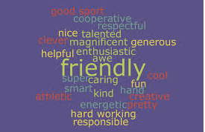
WORD CLOUD IDENTITIES
Notes:
https://www.abcya.com/games/word_clouds or https://worditout.com/word-cloud/create or https://monkeylearn.com/word-cloud/result
REMEMBER to use ~ (tilda) between words you want to keep together like Ice~cream

Slide 3
Identities = Who AM I
Many Different Layers of Identity
Notes:
Brainstorm on what makes up someone’s identity

Slide 4
Some Identity Factors...
Race, Culture, Age
Hobbies & Milestones
Character
Family & Friends
Job

Slide 5
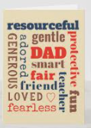
Identity Word Cloud
Who are YOU??
Character Traits | Job | Family & Friends | Hobby or Interests | Life Milestones | Culture, Race, Religion, Age
Motivated | Teacher | Spouse/Partner | Sports | Graduation | BIPOC
Outgoing | Salesman | Grandparent | Movies | Married | Female
Funny | Engineer | Son/ Daughter | Travel | Divorce | Faith
Spiritual | Student | Large family | Dance | Stroke | Young adult
Curious | Mechanic | Alone | Singing | New home | Middle age
or……. | or….. | or…. | or…. | or…. | or….
Notes:
These are sample categories to get across a lot of things contribute. We’ll take it a category at a time and share highlights
BIPOC= Black, Indigenous, (and) People of Color

Slide 6
CHARACTER TRAITS
Motivated | Respectful | Determined
Outgoing | Shy | Adventurous
Funny | Generous | Hard working
Spiritual | Helpful | Friendly
Curious | Hot-temper | Loving
Caring | Calm | Honest
Smart | Frustrated | Athletic
Creative | Happy | ???

Slide 7
Career--Jobs
Teacher | Pilot | Student
Administrator | Retail | Retired
Engineer | Salesman | Home manager
Healthcare provider | Construction | Librarian
Janitor | Musician | Food industry
Mechanic | Accountant | ???

Slide 8
Family & Friends Relationships
Spouse/ Partner | Large family | Club member
Grandparent | Small family | Faith-based group
Son/ Daughter | Alone | Volunteer
Sister/ Brother | Widow/Widower | Sports team Member
Mother/ Father | Best friend | Pet owner
Aunt/ Uncle | Neighbor | ???
Notes:
Could adapt and add location as well...east coast, west coast, mid west, urban, country, suburban…..

Slide 9
Hobbies
Sports | Board games | Social Media
Movies | Fitness | Baking
Travel | Arts & Crafts | Do-it-yourself projects
Dance | Reading | Fishing or Hunting
Singing & Music | Writing | Volunteer
Gardening | Video games | Card games
Aphasia groups | Golf | ???

Slide 10
Life Milestones
Graduation | First car | Kid’s wedding
Marriage | Special trip | Job promotion
Divorce | Move to new place | Retirement
Stroke | Loss of loved one | Cancer survivor
New home | TBI | Special award
Pet | Baby | ???

Slide 11
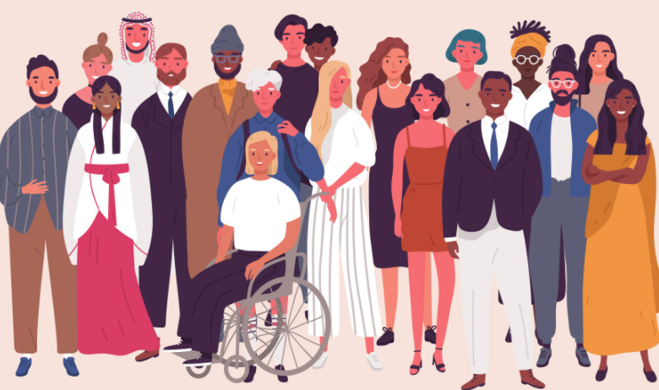
Culture, Race, Religion, Gender, Sexual Orientation, Age

Slide 12
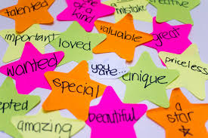
Rebuilding POSITIVE Identity with Aphasia
Notes:
Brainstorm what positive things they’ve learned about themselves in process of recovery?

